Slide 1

Exploratory Analysis of Socio-economic factors of Demographics in England (2021)
Presented by: Ayokunle James OLAGUNJU

Slide 2
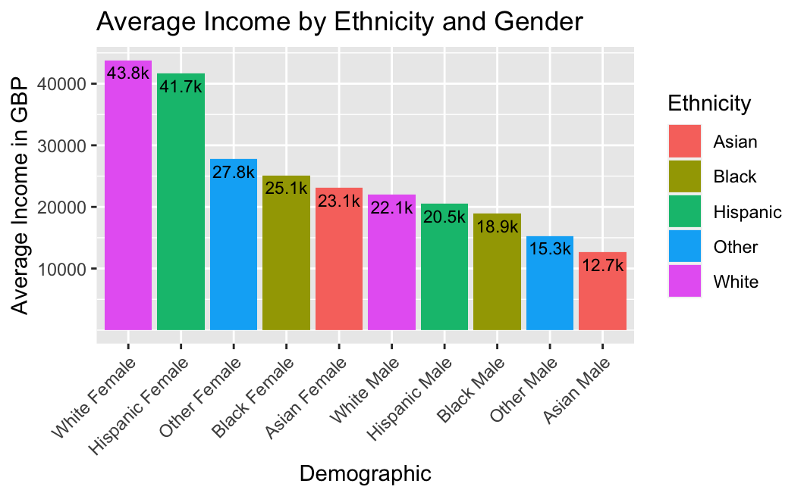
Income by Ethnicity and Gender
The highest earning demographic are White females with an average annual income of 43,806 GBP while the lowest earning demographic are Asian Males with an average annual income of 12,701 GBP.
It also appears that females earn more on average than Males, irrespective of their ethnicities.
White Males, the highest earning male demographic earn an average of 22.1k GBP, almost 50% lower than the highest earning female demographic. Huge disparity in Income can be observed here.

Slide 3
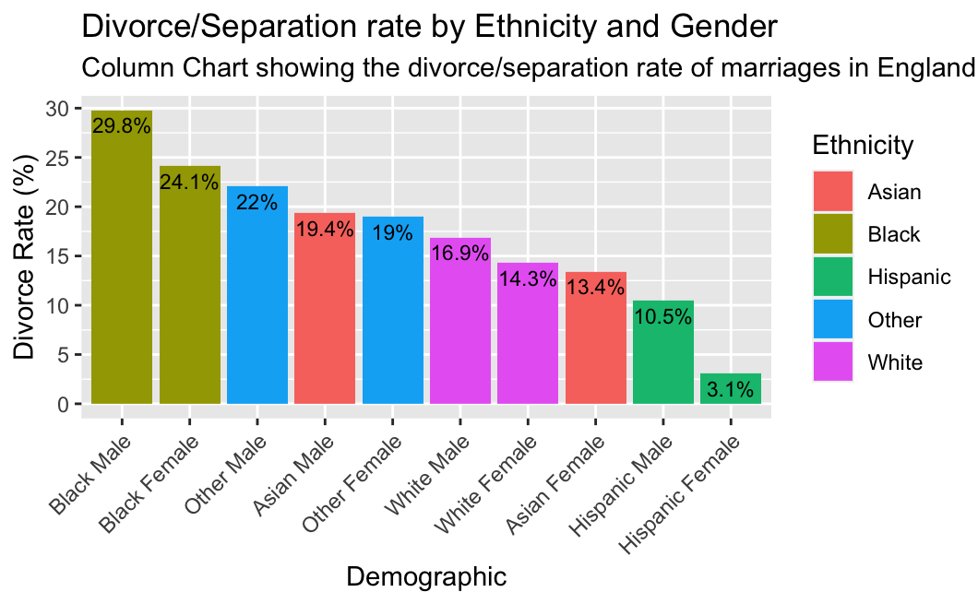
Divorce and Separation Rates
According to Karney (2021) and Copen et al. (2012), lower socio-economic status couples are more likely to get divorced than higher-SES counterparts.
From my analysis, demographics of lower socio-economic status in terms of level of education and average income appear to have a higher separation rate.
Black males have the highest divorce/separation rate of all demographics in England (2021) at 29.8%. They are closely followed by Black females at 24.1%. Other Males and Asian Males follow closely at 22% and 19.4% respectively.
Hispanic Males and Females have the lowest separation rates at 10.5% and 3.1% respectively.

Slide 4
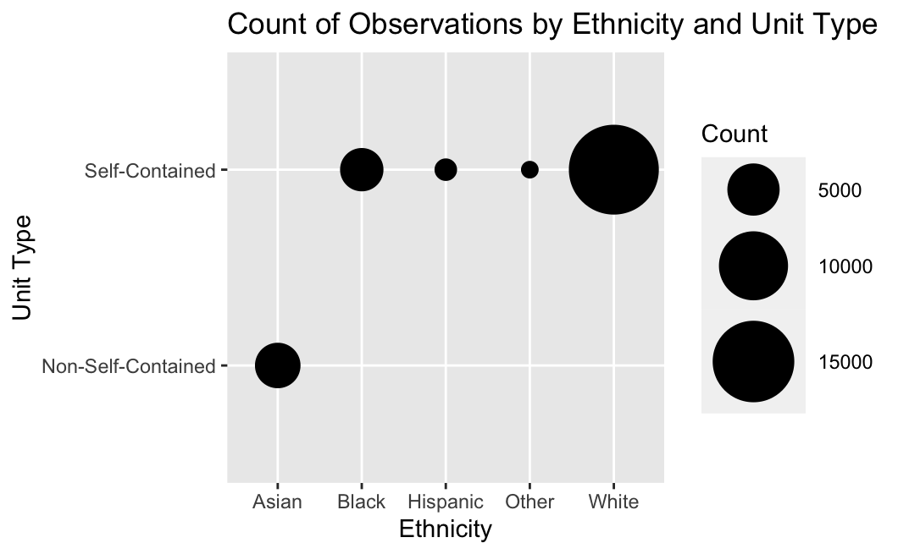
Housing Condition – Unit Type
The plot circles represent the mapping of the count of observations at each Ethnicity – Unit type location. The area of each circle indicates the count of each observation.
ALL non-self-contained units in the dataset are occupied by Asians.
All Asians in the dataset (3547 in number) live in non-self-contained units.
On the other hand, Blacks live in ONLY Self-contained units, likewise Hispanics, Whites and Others.
There is a huge count of whites as observed from the plot above due to a higher White population (18,929) .
The plot circles for Hispanics and Others are small due to the small population of both demographics in the observation (936 and 853 respectively).

Slide 5
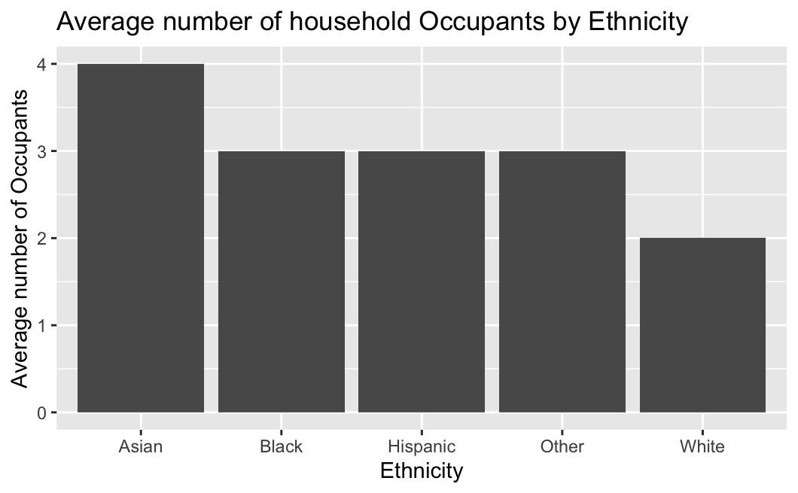
Housing Condition – Average number of Occupants
Asians have the highest average number of occupants in a household, despite having the least favorable kind of housing unit.
Asians have 4 occupants per household on average.
Blacks, Hispanics and Others all have an average of 3 occupants per household.
Whites have the least number of occupants per household with only 2 occupants on average.
It can be asserted that Asians have the worst housing/living condition while Whites have the most favorable living conditions

Slide 6
Limitations of Dataset
H8 - Housing Condition Analysis: during my analysis, I discovered a problem with the dataset where different answers were given to the question H8 by different persons in the same household. This was observed in 326 households, and it affected my ability to accurately analyze the housing conditions-unit type especially for those households. Google Spreadsheet showing ID of those households here.
Income: To better understand the income distribution of the demographics, I would have loved to have a variable in the dataset for ‘Occupations’. This would have helped paint a clearer picture of income distribution and maybe provided explanation for some outliers.
Sample Bias: It can be observed that there is a bias in the dataset due to the high White population compared to other Ethnicities. To have a better understanding of minority Ethnicities (e.g. Hispanics, and Asians), I would have loved to know what type of immigrants most of them are. Are they Skilled workers, Student Visa Holders, Refugees? This would have helped to better understand observations like their highest level of education, which in turn helps understand their Income, consequently influencing their living conditions.

Slide 7
References
Arnold, Jeffrey B. 2021. “Ggthemes: Extra Themes, Scales and Geoms for ’Ggplot2’.” https://CRAN.R-project.org/package=ggthemes.
Copen, Casey E., Kimberly Daniels, Jonathan Vespa, and William D. Mosher. 2012. “First Marriages in the United States: Data from the 2006-2010 National Survey of Family Growth.” National Health Statistics Reports, no. 49: 1–22.
Karney, Benjamin R. 2021. “Socioeconomic Status and Intimate Relationships.” Annual Review of Psychology 72 (1): 391–414. https://doi.org/10.1146/annurev-psych-051920-013658.
Wickham, Hadley. 2014. “Tidy Data.” Journal of Statistical Software 59 (10). https://doi.org/10.18637/jss.v059.i10.
Wickham, Hadley, Mara Averick, Jennifer Bryan, Winston Chang, Lucy D’Agostino McGowan, Romain François, Garrett Grolemund, et al. 2019. “Welcome to the Tidyverse” 4: 1686. https://doi.org/10.21105/joss.01686.

